Slide 1


Our Target Market
Business personalities
Three Star and above level hotels
Premium resorts
Our Value Proposition
In the current pandemic situation, our model can bring consistent business to the hotels since it follows strict health protocols and fast and smooth process.
Hotels with our model will be future-proof and generates more revenue.
Presented By
Vamsi Muvvala
Sarath Kanagala
Devi Venkat Kunchala
Prashanth Erugurala

Slide 2
Addressing the Problem
Hotels involve a lot of human intervention and face-to-face interaction with the staff, making the customers more prone to infections.
Customers face longer wait times during peak business hours.
Carrying keys with big RFID tags while leaving the room is a pain.
People sometimes forget their IDs in a hurry.

Slide 3
Key Winning Features
Key Characteristics | How are we achieving those? And why is it important?
Interaction Free Check-Ins and Check- Outs | This application helps the customer to select the Hotel rooms with the best amenities. Once the booking is successful customer receives a Unique QR-Code which needs to be scanned at the hotel entrance to enter the room directly without any interaction with the Hotel Staff.
User Friendly Interface | GetInn offers a good user-friendly interface which allow customers to easily navigate through website. Our website is compatible with both desktops and mobile phones making it easier to book a hotel comfortably at home or for the bookings on the go when in a rush.
Integrated Payment Gateway | We will provide a variety of payment options like Debit card, Credit card, Internet banking to choose from.
Data Analysis | Admin will get the entire analysis of what customers like the most about our product. This helps in improvement of the customer’s safe hotel stays.
Quick and Responsive Customer Support | Our hotel reservation system has a dedicated Customer support Department which is ready to listen and resolve the issues effectively irrespective of timings.

Slide 4
Capabilities
Cost Efficient: With the pandemic effecting the economy the need for reducing Hotel operation cost intensifies. With the QR-Code implementation, the hotels can cut the cost by reducing the hotel staff.
Best Hospitality Operations : QR-Codes for hotels can drive the future of hospitality operations. Because of this our hotel Check-In and Check-Out steps will no longer use the “First come, First serve” policy. Using this innovative technology, travelers can enjoy their adventure without needing to quickly rush to the hotel to check-in during the peak seasons.
Gives new experience to the guests: The reason why people when travelling choose to stay in our hotel is to collect new travel experience. With this implementation, hotels are finding new means to give their guests a new hotel experience by engaging them with modern technology transactions.
Customer Reviews: Hotels earn their rankings through constructive customer reviews. The admin can use this review and feedback data to analyze what needs to be improved to maintain the consistent business.

Slide 5
Justification
During the pandemic hotel businesses have lost $46 billion in revenue in the US alone and hundreds of billion dollars around the world.
Surviving the pandemic is the only key means to keep the hotel their businesses running.
So, We have provided a business model which follow strict health protocols and practices.
 | GetInn | Treebo Hotels | Fab Hotels
Human Interaction | None | High | High
Wait Times | None | Medium to High | Medium to High
Sanitization Times | Time Stamps | None | None

Slide 6
How we make Money?
Commissions from hotels and resorts.
Advertising on our website.
We offer our premium service free for 1-month to get the customers experience our product. This will get us more business.
We’ll have a contract with the Hotels to offer complimentary cuisines exclusively to the premium customers to attract more customers.

Slide 7
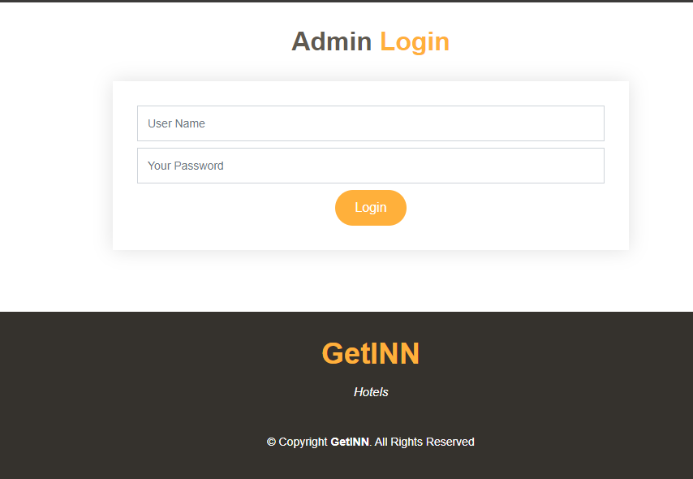
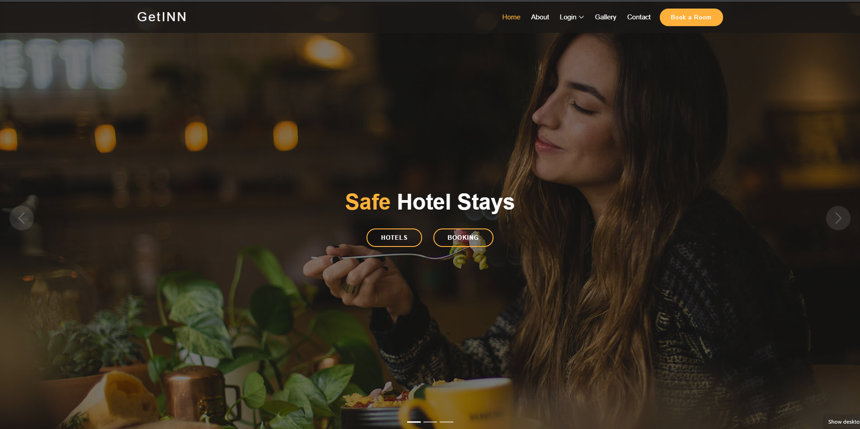
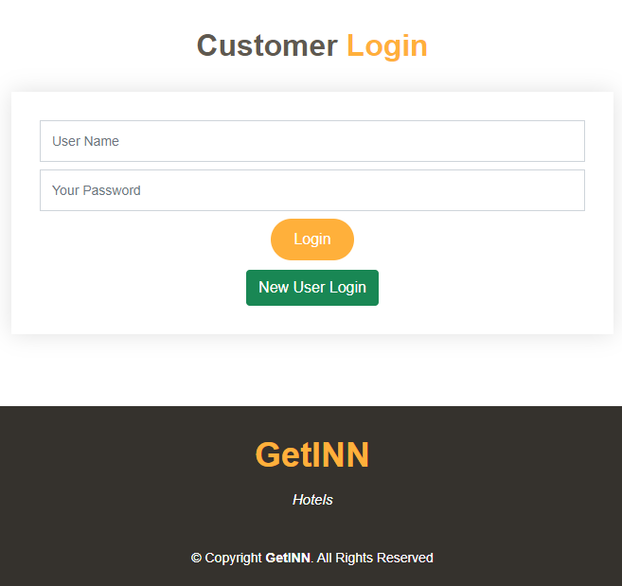
Conclusion
Front-End development has been completed.
Customers can look up the collection of hotels we have tie ups with.
Bookings can be done using the “Booking” or “Book a Room” buttons.

Slide 8
Plan of Action
October 21st
November 5th
November 12th
November 20th
November 27th
Done the research on how the required technologies work
Back-End for base and hompage development Begin
Back-End for Admin and Customer pages was designed
Database connections and dataset training
Final Scale-up

Slide 9
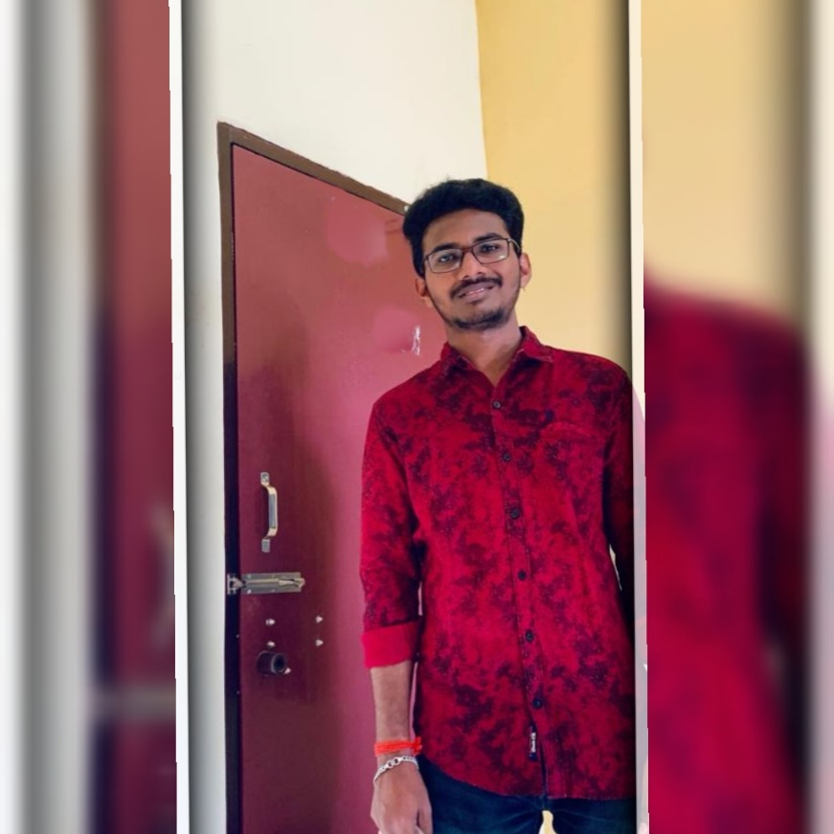


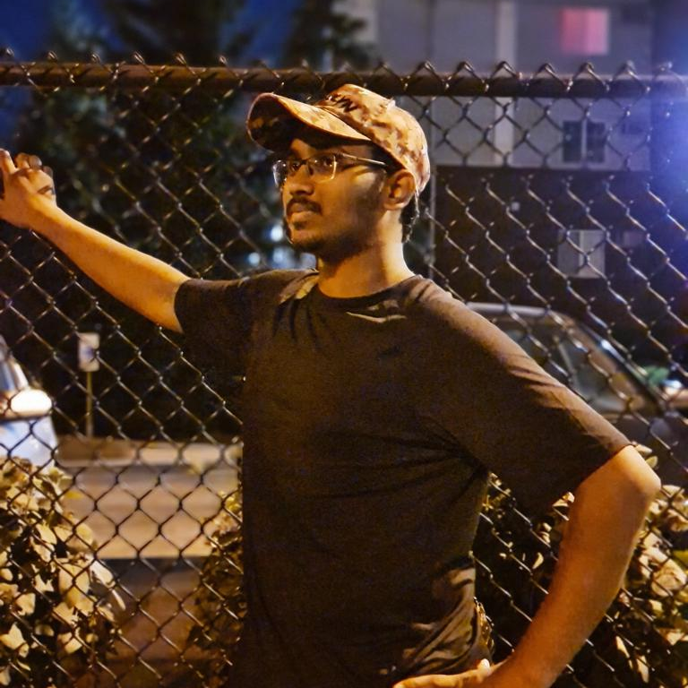
Devi Venkat Kunchala
Software Engineer
Prashanth Erugurala
UI Developer
Vamsi Muvvala
Data Analyst
Sarath Kanagala
Software Engineer

Slide 10
Thank You!

